Slide 1
CS310 Operating Systems Lecture 37 : File System System – 5 File Descriptor Manipulation
Ravi Mittal
IIT Goa

Slide 2
Acknowledgements !
Contents of this class presentation has been taken from various sources. Thanks are due to the original content creators:
CS162, Operating System and Systems Programming, University of California, Berkeley

Slide 3
Reading
Book: Linux System Programming: talking directly to the kernel and C library, by Robert Love
Class presentation: University of California, Berkeley, CS162

Slide 4
Previous Classes

Slide 5
C library High level APSs vs Linux Syscalls
A C library function is a function implemented by the C library implementation
C interface the library provides programmers to access kernel related functions
If a C programmers directly uses file syscalls, he/she needs to read the documentation
Each syscall has a number of arguments – makes programming complicated
A user most of the time may not use all arguments
User space programs are expected to find out arguments for each syscall by for example inspecting the documentation
A C library function is a function implemented by the C library implementation
Adapted from: Linux programming: Robert Love

Slide 6
Opening a file
#include <stdio.h>
FILE *fopen( const char *path, const char *mode );
This function opens the file path with the behavior given by mode and associates a new stream with it.

Slide 7
read() syscall vs fread() API - User space
Int main(){
int fd = open(“foo.txt”, “O_RDONLY”); // for I/O syscall
FILE *fs = fopen(‘bar.txt”, “w”); // for C lib I/O
User space
Process 1101
main
fd
fs
fd1
buff
3
4
struct sfio-s (aka FILE)
Call stack
Heap

Slide 8
Kernel Maintains State
char buffer1[100];
char buffer2[100];
int fd = open(“foo.txt”, O_RDONLY);
read(fd, buffer1, 100);
read(fd, buffer2, 100);
The kernel remembers that the fd corresponds to foo.txt
The kernel picks up where it left off in the file
Class presentation: CS 162 at UC Berkeley

Slide 9
State Maintained by the Kernel
On a successful call to open():
A file descriptor (int) is returned to the user
An open file description is created in the kernel
For each process, the kernel maintains a mapping from file descriptor to open file description
On future system calls (e.g., read()), the kernel looks up the open file description corresponding to the provided file descriptor and uses it to service the system call
Class presentation: CS 162 at UC Berkeley

Slide 10
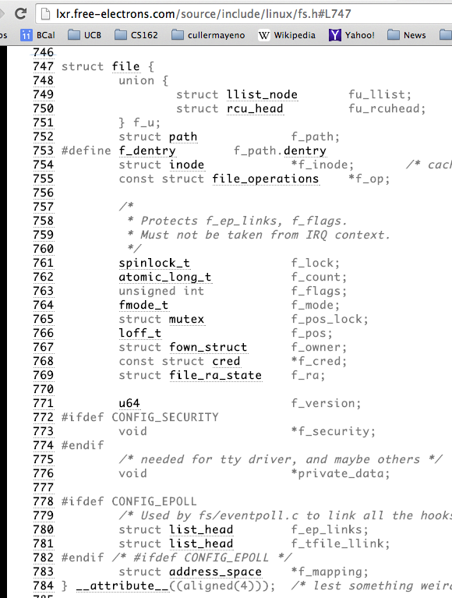
What’s in an Open File Description?
For our purposes, the two most important things are:
Where to find the file data on disk
The current position within the file

Slide 11
Today, we will study
Use of file descriptor within a process or across multiple processes

Slide 12
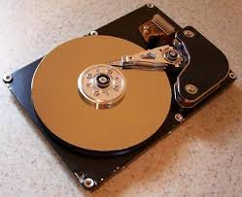
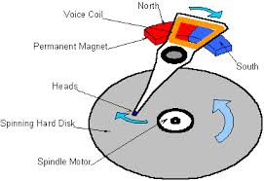
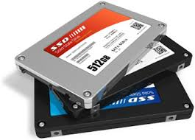

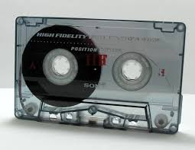
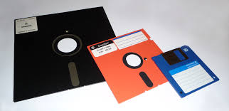
Today, we will study..
Application / Service
High Level I/O
Streams
Low Level I/O
File Descriptors
Syscall
open(), read(), write(), close(), …
Open File Descriptions
File System
Files/Directories/Indexes
I/O Driver
Commands and Data Transfers
Disks, Flash, Controllers, DMA

Slide 13
Abstract Representation of a Process
Process
Suppose that we execute
open(“foo.txt”)
and that the result is 3
Thread’s Regs
Address Space (Memory)
…
User Space
Kernel Space
File Descriptors
Open File Description
3
Not shown: Initially contains 0, 1, and 2 (stdin, stdout, stderr)
File: foo.txt
Position: 0

Slide 14
Abstract Representation of a Process
Process
Suppose that we execute
open(“foo.txt”)
and that the result is 3
Next, suppose that we execute
read(3, buf, 100)
Thread’s Regs
Address Space (Memory)
…
User Space
Kernel Space
File Descriptors
Open File Description
3
Not shown: Initially contains 0, 1, and 2 (stdin, stdout, stderr)
File: foo.txt
Position: 0

Slide 15
Abstract Representation of a Process
Process
Suppose that we execute
open(“foo.txt”)
and that the result is 3
Next, suppose that we execute
read(3, buf, 100)
The file position is 100
Thread’s Regs
Address Space (Memory)
…
User Space
Kernel Space
File Descriptors
Open File Description
3
Not shown: Initially contains 0, 1, and 2 (stdin, stdout, stderr)
File: foo.txt
Position: 100

Slide 16
Abstract Representation of a Process
Process
Suppose that we execute
open(“foo.txt”)
and that the result is 3
Next, suppose that we execute
read(3, buf, 100)
Finally, suppose that we execute
close(3)
Thread’s Regs
Address Space (Memory)
…
User Space
Kernel Space
File Descriptors
Open File Description
3
Not shown: Initially contains 0, 1, and 2 (stdin, stdout, stderr)
File: foo.txt
Position: 100

Slide 17
Abstract Representation of a Process
Process
Suppose that we execute
open(“foo.txt”)
and that the result is 3
Next, suppose that we execute
read(3, buf, 100)
Finally, suppose that we execute
close(3)
Thread’s Regs
Address Space (Memory)
…
User Space
Kernel Space
File Descriptors
Not shown: Initially contains 0, 1, and 2 (stdin, stdout, stderr)

Slide 18
Now, let’s fork()!
Process 1
Process 2
Thread’s Regs
Address Space (Memory)
File descriptor is copied
Open file description is aliased
Thread’s Regs
Address Space (Memory)
…
…
User Space
Kernel Space
File Descriptors
Open File Description
File Descriptors
3
3
Not shown: Initially contains 0, 1, and 2 (stdin, stdout, stderr)
File: foo.txt
Position: 100

Slide 19
Open File Description is Aliased
Process 1
Process 2
read(3, buf, 100)
Thread’s Regs
Address Space (Memory)
Thread’s Regs
Address Space (Memory)
…
…
User Space
Kernel Space
File Descriptors
Open File Description
File Descriptors
3
3
Not shown: Initially contains 0, 1, and 2 (stdin, stdout, stderr)
File: foo.txt
Position: 100

Slide 20
Open File Description is Aliased
Process 1
Process 2
Thread’s Regs
Address Space (Memory)
Thread’s Regs
Address Space (Memory)
…
…
User Space
Kernel Space
File Descriptors
Open File Description
File Descriptors
3
3
Not shown: Initially contains 0, 1, and 2 (stdin, stdout, stderr)
File: foo.txt
Position: 200

Slide 21
Open File Description is Aliased
Process 1
Process 2
read(3, buf, 100)
Thread’s Regs
Address Space (Memory)
Thread’s Regs
Address Space (Memory)
…
…
User Space
Kernel Space
File Descriptors
Open File Description
File Descriptors
3
3
Not shown: Initially contains 0, 1, and 2 (stdin, stdout, stderr)
File: foo.txt
Position: 200

Slide 22
Open File Description is Aliased
Process 1
Process 2
Thread’s Regs
Address Space (Memory)
Thread’s Regs
Address Space (Memory)
…
…
User Space
Kernel Space
File Descriptors
Open File Description
File Descriptors
3
3
Not shown: Initially contains 0, 1, and 2 (stdin, stdout, stderr)
File: foo.txt
Position: 300

Slide 23
File Descriptor is Copied
Process 1
Process 2
close(3)
Thread’s Regs
Address Space (Memory)
Thread’s Regs
Address Space (Memory)
…
…
User Space
Kernel Space
File Descriptors
Open File Description
File Descriptors
3
3
Not shown: Initially contains 0, 1, and 2 (stdin, stdout, stderr)
File: foo.txt
Position: 300

Slide 24
File Descriptor is Copied
Process 1
Process 2
Thread’s Regs
Address Space (Memory)
Thread’s Regs
Address Space (Memory)
Open file description remains alive until no file descriptors in any process refer to it
…
…
User Space
Kernel Space
File Descriptors
Open File Description
File Descriptors
3
Not shown: Initially contains 0, 1, and 2 (stdin, stdout, stderr)
File: foo.txt
Position: 300

Slide 25
Why is Aliasing the Open File Description a Good Idea?
It allows for shared resources between processes

Slide 26
In Linux, Everything is a File
Identical interface for:
Files on disk
Devices (terminals, printers, etc.)
Regular files on disk
Networking (sockets)
Local inter-process communication (pipes, sockets)
Based on the system calls open(), read(), write(), and close()

Slide 27
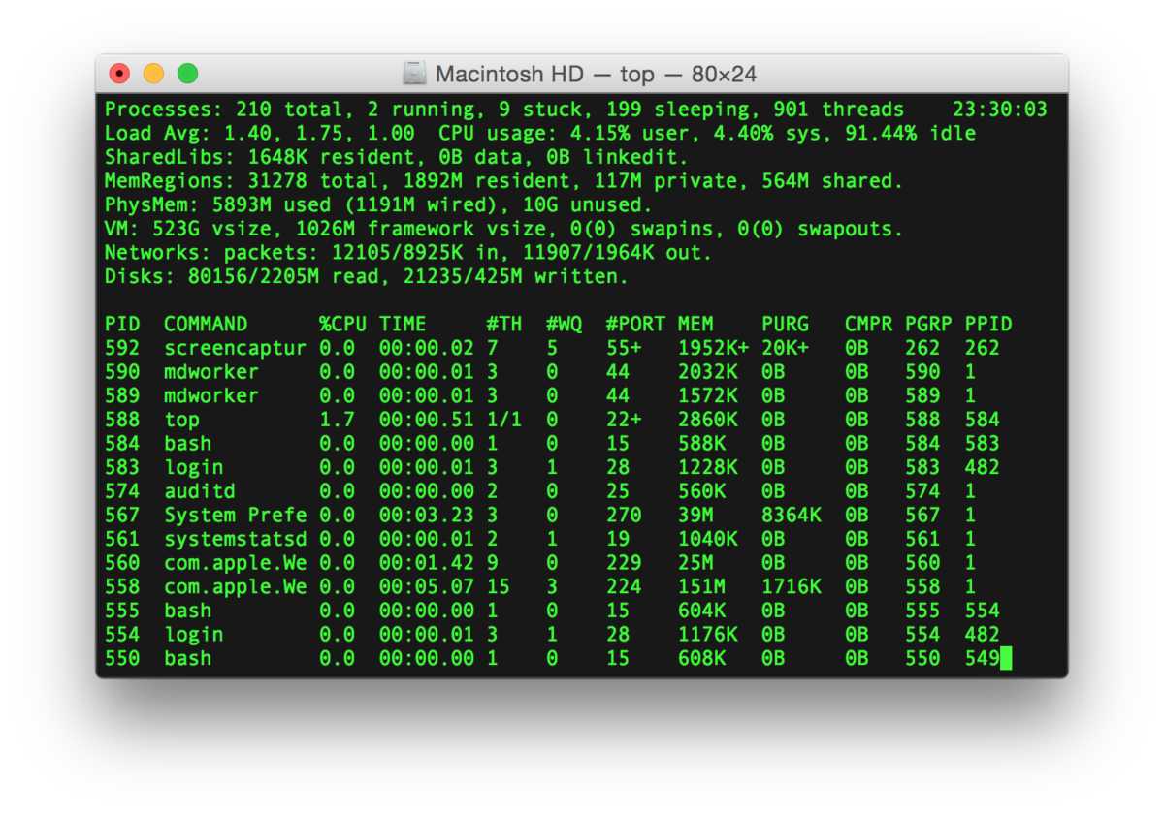
Example: Shared Terminal Emulator
Process 1
Process 2
Thread’s Regs
Address Space (Memory)
Thread’s Regs
Address Space (Memory)
…
…
User Space
Kernel Space
Terminal Emulator
File Descriptors
File Descriptors
0
1
2
0
1
2

Slide 28
Example: Shared Terminal Emulator
Process 1
Process 2
close(0)
Thread’s Regs
Address Space (Memory)
Thread’s Regs
Address Space (Memory)
…
…
User Space
Kernel Space
Terminal Emulator
File Descriptors
File Descriptors
0
1
2
0
1
2

Slide 29
Example: Shared Terminal Emulator
Process 1
Process 2
close(0)
If one process closes stdin (0), it remains open in other processes
Thread’s Regs
Address Space (Memory)
Thread’s Regs
Address Space (Memory)
…
…
User Space
Kernel Space
Terminal Emulator
File Descriptors
File Descriptors
0
1
2
0
1
2

Slide 30
Other Syscalls: dup and dup2
They allow you to duplicate the file descriptor
But the open file description remains aliased

Slide 31
Other Syscalls: dup and dup2
Process
Suppose that we execute
open(“foo.txt”)
and that the result is 3
Next, suppose that we execute
read(3, buf, 100)
and that the position is 100
Next, suppose that we execute
dup(3)
And that the result is 4
Finally, suppose that we execute
dup2(3, 162)
Thread’s Regs
Address Space (Memory)
…
User Space
Kernel Space
File Descriptors
Open File Description
3
4
162
Not shown: Initially contains 0, 1, and 2 (stdin, stdout, stderr)
File: foo.txt
Position: 100
Notes:
The difference between dup and dup2 is that dup assigns the lowest available file descriptor number, while dup2 lets you choose the file descriptor number

Slide 32
Pitfalls of OS abstraction

Slide 33
Don’t fork() in a process that already has multiple threads
Unless you plan to call exec() in the child process

Slide 34
fork() in Multithreaded Processes (in POSIX)
The child process always has just a single thread
The thread in which fork() was called
The other threads of the child process just vanish without any notice

Slide 35
fork() in a Multithreaded Processes
Process 1
Process 2
Thread 1 Regs
Address Space (Memory)
Only the thread that called fork() exists in the new process
Thread 1 Regs
Address Space (Memory)
Thread 2 Regs
…
User Space
…
Kernel Space
File Descriptors
Open File Description
File Descriptors
3
3
Not shown: Initially contains 0, 1, and 2 (stdin, stdout, stderr)
File: foo.txt
Position: 100

Slide 36
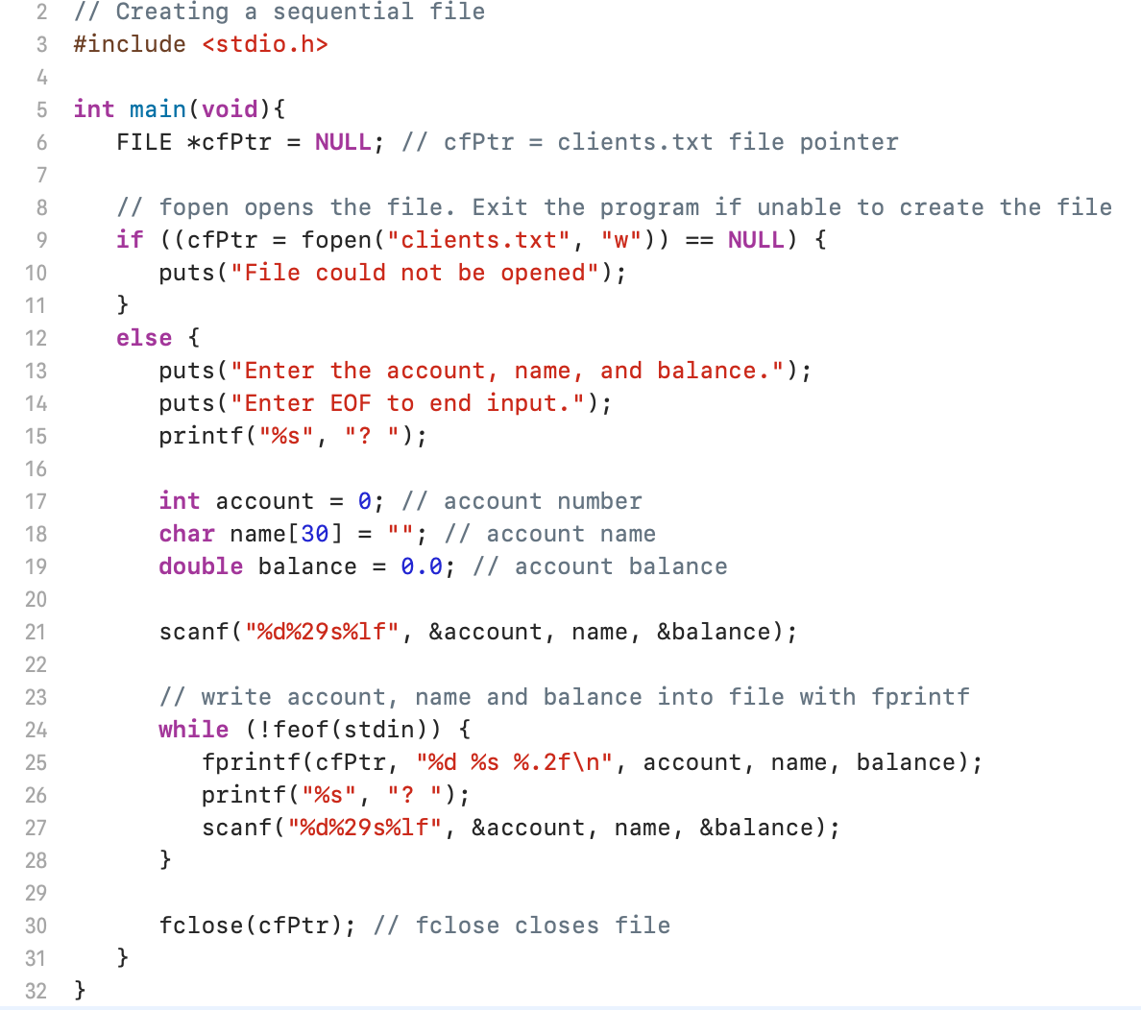
pfile2.c

Slide 37
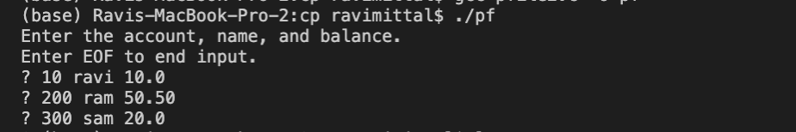
$ cat clients.txt
EOF character
Linux/MAC OS : <Ctrl> d
Windows: <Ctrl> z enter

Slide 38
Lecture Summary
File descriptors can be manipulated within processes or across processes

